Slide 1

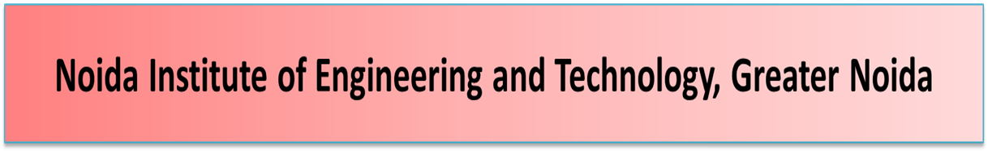
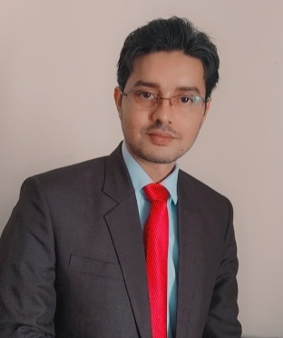
Introduction to Quality Management
Unit: 1
Subject Name – Total Quality Management
Faculty Name – Mr. Minhaj Nezami
Assistant Professor
Department - IT
Course – B. Tech 8th Semester

Slide 2

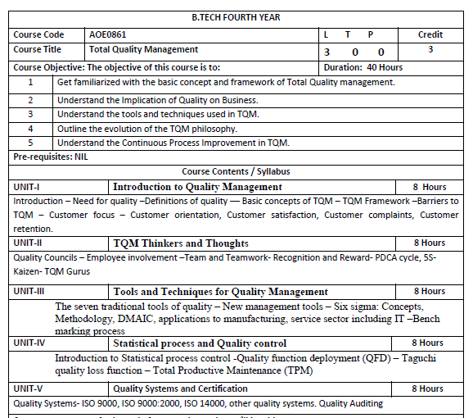

Slide 3

AOE 0861.1 | To learn about common term Quality Concepts
AOE0861.2 | To know QM principle
AOE0861.3 | To understand the importance of different chart like P-charts and C-charts
AOE0861.4 | To know new term PDCE cycle, 5S, Kaizen
AOE0861.5 | To be aware about different ISO standards and JIT

Slide 4




Unit 1 Objective
To learn about common term related to Quality Concepts

Slide 5
Course Outcome
AOE0861.1 | Define the Quality Concepts and Manufacturing Quality
AOE0861.2 | Conceptualize the term Quality Management and relate to this various QM Principles
AOE0861.3 | Analyze the different Tools and Techniques and Control Charts
AOE0861.4 | Distinguish between Defects Diagnosis and Prevention term
AOE0861.5 | Coordinate IS0 and its concept to Quality Management

Slide 6
Program Outcome
1. Engineering knowledge
2. Problem analysis
3. Design/development of solutions
4. Conduct investigations of complex problems
5. Modern tool usage
6. The engineer and society
7. Environment and sustainability
8. Ethics
9. Individual and team work
10. Communication
11. Project management and finance
12. Life-long learning

Slide 7
CO-PO Mapping
CO | PO1 | PO2 | PO3 | PO4 | PO5 | PO6 | PO7 | PO8 | PO9 | PO10 | PO11 | PO12
AOE0861.1 | 3 | 3 | 2 | 2 | 1 | 2 | 2 | 1 | 1 | 1 | 2 | 3
AOE0861.2 | 3 | 3 | 3 | 3 | 2 | 2 | 2 | 1 | 1 | 1 | 2 | 3
AOE0861.3 | 3 | 3 | 2 | 3 | 3 | 2 | 2 | 1 | 2 | 1 | 2 | 3
AOE0861.4 | 3 | 2 | 3 | 2 | 2 | 2 | 2 | 1 | 2 | 1 | 3 | 3
AOE0861.5 | 3 | 2 | 3 | 2 | 2 | 2 | 2 | 1 | 2 | 1 | 2 | 3
Avg | 3 | 2.6 | 2.6 | 2.4 | 2 | 2 | 2 | 1 | 1.6 | 1 | 2.2 | 3

Slide 8
Program Specific Outcome
On successful completion of graduation degree, The computer Science & Engineering graduates will be able to:
PSO1: identify, analyze real world problems and design their ethical solutions using artificial intelligence, robotics, virtual/augmented reality, data analytics, block chain technology, and cloud computing.
PSO2: design and develop the hardware sensor devices and related interfacing software systems for solving complex engineering problems.
PSO 3: understand inter-disciplinary computing techniques and to apply them in the design of advanced computing.
PSO 4: conduct investigation of complex problem with the help of technical, managerial, leadership qualities, and modern engineering tools provided by industry sponsored laboratories.

Slide 9
CO-PO Mapping
CO | PSO1 | PSO2 | PSO3
AOE0861.1 | 3 | 2 | 3
AOE0861.2 | 3 | 2 | 2
AOE0861.3 | 3 | 2 | 3
AOE0861.4 | 3 | 3 | 3
AOE0861.5 | 3 | 2 | 3
Avg | 3 | 2.2 | 2.8

Slide 10
Program Educational Objectives
PEO 1: To have an excellent scientific and engineering breadth so as to comprehend, analyze, design and provide sustainable solutions for real-life problems using state-of-the-art technologies.
PEO 2: To have a successful career in industries, to pursue higher studies or to support entrepreneurial endeavors and to face the global challenges.
PEO 3: To have an effective communication skills, professional attitude, ethical values and a desire to learn specific knowledge in emerging trends, technologies for research, innovation and product development and contribution to society.
PEO 4: To have life-long learning for up-skilling and re-skilling for successful professional career as engineer, scientist, entrepreneur and bureaucrat for betterment of society.

Slide 11
Syllabus of Unit 1
Introduction
Need for quality
Definitions of quality
Basic concepts of TQM
TQM Framework
Barriers to TQM
Customer focus
Customer orientation
Customer satisfaction
Customer complaints
Customer retention

Slide 12
Objective of Quality
To exceed performance over expectation for a product or service.
CO | PO1 | PO2 | PO3 | PO4 | PO5 | PO6 | PO7 | PO8 | PO9 | PO10 | PO11 | PO12
AOE0861.1 | 3 | 3 | 2 | 2 | 1 | 1 | 2 | 1 | 1 | 1 | 2 | 2

Slide 13
Quality Concept (CO1)
Quality is meeting the customer's needs in a way that exceeds the customer's expectations.
Quality could be defined as a basic tool for a natural property of any good or service that allows it to be compared with any other good or service of its kind. The word quality refers to the set of inherent properties of an object that allows satisfying stated or implied needs.

Slide 14
Quality Concept (CO1)
The following are types of quality
Product Quality
Service Quality
Experience Quality
IT Quality
Data Quality
Information Quality
Quality of life

Slide 15
Precap of Quality
External customer
Internal customer
Fulfill customer expectations
Customer's expectations

Slide 16
Customer (CO1)
In sales, commerce and economics, a customer (sometimes known as a client, buyer, or purchaser) is the recipient of a good service, product or an idea - obtained from a seller, vendor, or supplier via a financial transaction or exchange for money or some other valuable consideration

Slide 17
Internal Customer
Internal customers have a relationship with, and within, your company, either through employment or as partners who deliver your product or service to the end user, the external customer. Less obvious but certainly still significant, stakeholders and shareholders are also internal customers. All of these may or may not purchase your product or service.

Slide 18
External Customer
An external customer is a person who is not directly connected to your organization other than by purchasing your product or service. This customer could be a one-time purchaser or a person who’ve you worked with long-term and to whom you’ve provided add-ons or customization options. External customers are also known as “clients” or “accounts.”

Slide 19
Customer Expectations
Customer expectations are defined as the set of behaviors, responses, offers, prices, products or services improvements, experiences, and personalization that customers anticipate or expect from a particular brand while interacting.

Slide 20
Daily Quiz
1. How will you quantify the term quality?
What is customer's expectations?
3. What is external customer ?
What is Internal customer?

Slide 21
Basic Concept of TQM
Total Quality Management (TQM) is a management framework based on the belief that an organization can build long-term success by having all its members -- from low-level workers to its highest-ranking executives -- focus on improving quality and, thus, delivering customer satisfaction.
This management approach is used to simplify supply chain management, as well as to detect, reduce or remove errors. TQM requires organizations to focus on continuous improvement, or Kaizen. TQM focuses on continual internal and process improvements over the long term, thereby enhancing the quality of produced products or services.

Slide 22
Importance of TQM
TQM can have a beneficial effect on employee and organizational development. By having all employees focus on quality management and continuous improvement, companies can establish and uphold cultural values that create long-term success for both customers and the organization. TQM's focus on quality helps organizations identify skill deficiencies in employees, along with the necessary training, education or mentoring required to address those needs.
With a focus on teamwork, TQM leads to the creation of cross functional teams and knowledge sharing. The increased communication and coordination across disparate groups deepens institutional knowledge and gives companies more flexibility in deploying personnel.

Slide 23
Principles of TQM
TQM prescribes a series of ways for organizations to accomplish this, with the pathway to successful continuous improvement centered on the use of strategy, data and effective communication to instill a discipline of quality into the organization's culture and processes.
More specifically, TQM highlights the processes that organizations use to produce their products, and it calls for organizations to define those processes, continuously monitor and measure their performance, and use that performance data to drive improvements. In addition, it requires all employees and organizational departments to be part of this process.

Slide 24
Principles of TQM
The eight guiding principles that TQM uses to improve quality include the following:
Customer focus. The customer determines the quality level of the products and services. Customer input is valued, as it provides a better understanding of what the customer needs.
Employee involvement. All employees must participate in the processes and system. They must be properly trained and given the needed resources to complete their tasks on time.

Slide 25
Principles of TQM
3. Focus on process. Processes must be continually analyzed to identify weaknesses. Every employee who takes part in the process should be properly educated in their contributions, ensuring the right steps are taken at the right time.
4. Integrated business systems. All TQM processes should be integrated into a business process. Integrated systems convey potentially useful data across departments, enabling everyone to be on the same page.

Slide 26
Basic Concept of TQM
5.Strategic and systematic approach. Planning and management are required using a strategic plan with quality as a base component.
6.Continual improvement. A focus on continually improving quality helps an organization adapt to changing markets and achieve competitive advantages.

Slide 27
Basic Concept of TQM
7. Focus on data. Data should be collected, documented and analyzed to improve decision-making accuracy and to predict trends based on previous history.
8.Communication. Communication between teams with information such as strategies, methodologies or timeliness is essential to improving operations. Good communication can also motivate employees and improve morale.

Slide 28
Implementation principles and processes
of TQM
The general process of implementing TQM follows these steps:
The organization assesses its current culture and quality management systems and identifies core values.
Management decides to commit to TQM and develops a TQM master plan.
The organization identifies and prioritizes customer demands.
Management maps the processes needed to meet customer needs.

Slide 29
Implementation principles and processes
of TQM
5. Management creates a team to oversee efforts to improve processes.
6. Management starts contributing to the process by providing additional planning and training.
7. Management creates a process to standardize daily process management.
8. Management continually asks employees for feedback.
Implementing TQM is a long-term commitment, and the length of time needed for planning, development and implementation varies by organization.

Slide 30
Benefits of TQM
Less product defects. An objective of TQM is to create products and services correctly the first time. This means that products ship with fewer defects, reducing product recalls, future customer support overhead and product fixes.
Satisfied customers. High-quality products that meet customers' needs result in higher customer satisfaction. High customer satisfaction, in turn, can lead to increased market share, revenue growth via upselling and word-of-mouth marketing initiated by customers.

Slide 31
Benefits of TQM
Lower costs. As a result of less product defects, companies save money on customer support, product replacements, field service and creating product fixes. The cost savings flow to the bottom line, creating higher profit margins.
Well-defined cultural values. Organizations that practice TQM develop and nurture core values around quality management and continuous improvement. The TQM mindset pervades across all aspects of an organization, from hiring to internal processes to product development.

Slide 32
Disadvantages of TQM
Planning and resources. TQM needs a significant amount of planning and resources over time to be properly allocated to the change.
Companywide commitment. Continuous improvement in TQM means the organizational culture must focus on improving processes. All management levels must be supportive.
Added costs. TQM might add training, infrastructure and team development costs.
Time. It might take years for an organization to fully show intended results.
Partial efforts. Because of the effort involved in implementing TQM, a partial move toward it can result in failure.

Slide 33
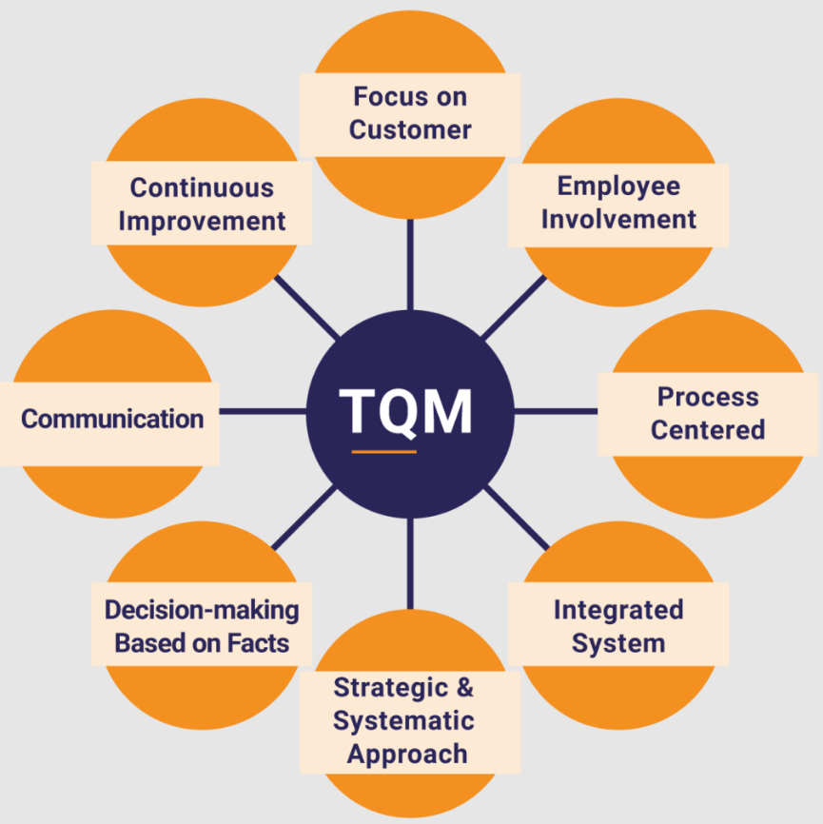
Overall Concept of TQM

Slide 34
QM Modern Concept
Quality management is the act of overseeing all activities and tasks needed to maintain a desired level of excellence. Quality management includes the determination of a quality policy, creating and implementing quality planning and assurance, and quality control and quality improvement.

Slide 35
QM Modern Concept
Customer-oriented process
Customer orientation is a business approach that puts the needs of the customer over the needs of the business. Customer-oriented companies understand that the business won't thrive unless it consistently improves customer focus. It's a way of thinking that aligns your business goals with your customers' goals.
Continuous improvement
Continuous improvement, sometimes called continual improvement, is the ongoing improvement of products, services or processes through incremental and breakthrough improvements. These efforts can seek "incremental" improvement over time or "breakthrough" improvement all at once.

Slide 36

Barriers to TQM
Lack of management commitment and support
Resistance to organizational culture change
Improper planning
Insufficient training and education
Incompatible organizational structures
Lack of cross-departmental coordination
Lack of resources for quality initiatives
Ineffective measurement techniques
A deficit in customer focus,employee empowerment, and continuous improvement, leading to a gap in commitment and understanding across the organization.

Slide 37
Customer Focus
Customer consider as most important asset of an organization
Consumer buy product and if they are satisfied will purchased more, in turn the organization will more profitable AND can compete over market
Thus an organization must define all its process and function with customer point of view

Slide 38
Customer Focus
It is important to identify the organization's customers.
External customers consume the organization's product or service.
Internal customers are employees who receive the output of other employees.

Slide 39
Customer Orientation
Customer orientation is a business approach that puts the needs of the customer over the needs of the business. Customer-oriented companies understand that the business won't thrive unless it consistently improves customer focus. It's a way of thinking that aligns your business goals with your customers' goals.
Building a customer-oriented culture means recognizing that customers are the business.

Slide 40
Customer Satisfaction
Customer satisfaction is a business metric that measures how well a company's products, services, or overall experience meet or exceed customer expectations. It reflects a customer's happiness with their interaction with a business and is used to gauge business health and identify areas for improvement, often through surveys and feedback.

Slide 41
Customer Complaints
Customer complaints are negative feedback about a company’s product, service, or support experience. Customers can share concerns privately through surveys or emails or publicly via social media, forums, and review sites.
Negative feedback can be an opportunity rather than a liability. If handled correctly, a complaint can strengthen your relationship with the customer and improve your operations.

Slide 42
Customer Retention
Customer retention is a measure of how many customers stay with your business for the long term. It's what demonstrates your business's ability to stimulate customers to make repeat purchases and spend more money on your products and services over time.

Slide 43
Daily Quiz
1. Briefly explain the term QM.
What is Customer-oriented process?
What is Continuous improvement Process?
Define QM Modern concept.
.

Slide 44
Objectives of Evolution of QM Philosophies
The evolution of quality management is described through the stages of inspection, quality control, quality assurance and to QM.
CO | PO1 | PO2 | PO3 | PO4 | PO5 | PO6 | PO7 | PO8 | PO9 | PO10 | PO11 | PO12
AOE0861.1 | 3 | 3 | 2 | 2 | 1 | 2 | 2 | 1 | 1 | 1 | 2 | 2

Slide 45
Evolution of QM Philosophies (CO1)
The Deming Philosophy
Definition of quality, “A product or a service possesses quality if it helps somebody and enjoys a good and sustainable market.”
Improve quality
Decrease cost because of less rework, fewer mistakes.
Productivity improves
Long-term competitive strength
Stay in business
Capture the market with better quality and reduced cost.

Slide 46
Daily Quiz
What is the Deming Philosophy?
Define good quality of product.
Discuss the concept of improve quality and productivity improve.

Slide 47
Objective of Guarantee
The purpose of Guarantee is to cover the Applicant/Instructing Party's ability to meet its payment obligations and the most common type covers the buyer's obligation to pay for goods received or services rendered
CO | PO1 | PO2 | PO3 | PO4 | PO5 | PO6 | PO7 | PO8 | PO9 | PO10 | PO11 | PO12
AOE0861.1 | 3 | 3 | 2 | 2 | 1 | 2 | 2 | 1 | 2 | 2 | 2 | 3

Slide 48
Prerequisite of Guarantee
The Deming Philosophy
Concept of Improve quality
Concept of Productivity improve

Slide 49
Guarantee (CO1)
Guarantee is a legal term more comprehensive and of higher import than either warranty or "security". It most commonly designates a private transaction by means of which one person, to obtain some trust, confidence or credit for another, engages to be answerable for him.
It may also designate a treaty through which claims, rights or possessions are secured.

Slide 50
Precap of Guarantee
Guarantee provides a confidence to customer about the quality of product or service.

Slide 51
Daily Quiz
What do you mean by warranty?
What do you mean by guarantee?
How are they being analyzed and set?

Slide 52
Objective of Deming Point
Deming said that production targets encourage high output and low quality. Provide support and resources so that production levels and quality are high and achievable. Measure the process rather than the people behind the process.
CO | PO1 | PO2 | PO3 | PO4 | PO5 | PO6 | PO7 | PO8 | PO9 | PO10 | PO11 | PO12
AOE0861.1 | 3 | 3 | 2 | 2 | 2 | 2 | 2 | 1 | 1 | 1 | 2 | 2

Slide 53
Prerequisite of Deming Point
Concept of Warranty
Concept of guarantee
provides a confidence to customer about the quality of product or service.

Slide 54
Deming Point (CO1)
Deming’s 14 points for Management were first presented in his book Out of the Crisis. With the 14 important management principles he offered a way to drastically improve the company’s effectiveness. Many of these management principles are philosophical in nature, and some are more programmatic.
All Deming’s 14 points for Management can bring about transformation. Below you will find a short description of the 14 points:

Slide 55
Deming Point (CO1)
1. Create constancy of purpose
Strive for constant improvement in products and services, with the aim of becoming competitive and ensuring consistency in the way business is done, which will ensure retention of employment. Do not just make adjustments at the end of the production process, but evaluate if improvements are necessary during the process and get started immediately.
2. The new philosophy
A new (economic) time offers new chances and challenges, and management must take responsibility for being open to such changes. Without change, a company can not sustain itself in a time when innovation occurs every day.

Slide 56
Deming Point (CO1)
3. Cease dependence on inspection
End the dependence on inspections and final checks to ensure quality. It is better to that quality checks take place during the process so that improvements can be made earlier. This section links back to the first point, which promotes the importance of interim improvements.
4. End ‘lowest tender’ contract
Move towards a single supplier for any one item. Stop doing business and negotiate with suppliers based on the lowest price. It is worthwhile in the long term to build a good and long-standing relationship with suppliers, which fosters trust and increases loyalty. An organization should be able to rely on their suppliers; they supply the parts for the production line and are the first link to a high quality product.

Slide 57
Deming Point (CO1)
5. Continually seek out problems
Improve constantly and forever. Continuous process improvement of production and service results in improved quality and productivity, which in turn leads to cost reduction. This part also relates to the first and third points. Improved quality leads to less waste of other raw materials, which subsequently has a cost-effective effect.
6. Institute training on the job
Training and development of employees is necessary for the survival of an organization. By integrating it into the organization, it will be considered as normal for the employees, as part of their Personal Development Plan.

Slide 58
Deming Point (CO1)
7. Institute supervision
Adopt and institute leadership. Leadership needs to be stimulated. By leading and supervising, managers are able to help employees and make machines work better. Their helicopter view ensures that they can see everything that happens on the workplace. They will also have to delegate more tasks so that they can fully focus on the big picture.
8. Drive out fear
Fear is paralyzing. Therefore, fear must be eliminated on the work floor so that everyone can work effectively for the company, feel safe and take risks. Transparent communication, motivation, respect and interest in each other and each other’s work can contribute to this.

Slide 59
Deming Point (CO1)
9. Break down barriers
By eliminating the boundaries between departments, cooperation can be better and different expert teams will understand each other better. This can be done by, for example, the creation of multifunctional teams, each with an equal share and open to each other’s ideas.
10. Eliminate exhortations
Remove ‘stimulating’ slogans from the workplace. Such slogans, warnings and exhortations are perceived as being patronizing. Quality and production problems do not arise from the individual employee, but from the system itself.

Slide 60
Deming Point (CO1)
11. Eliminate targets
No more focus on achieving certain margins; that impedes professionals from performing their work well and taking the necessary time for it. Rushing through the work can cause production errors. Managers should therefore focus on quality rather than quantity.
12. Permit pride of workmanship
Let employees be proud of their craftsmanship and expertise again. This relates back to the eleventh point. Employees feel more satisfaction when they get a chance to execute their work well and professionally, without feeling the pressure of deadlines.

Slide 61
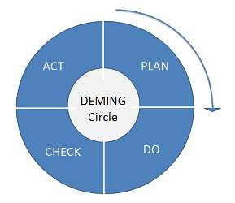
Deming Point (CO1)
13. Institute education
Integrate and promote training, self-development and improvement for each employee. This directly connects to the sixth point. By encouraging employees to work for themselves and to see their studies and training as a self-evident part of their jobs, they are able to elevate themselves to a higher level.
14. The transformation is everyone’s job
Transformation is the work of everyone. Set forth concrete actions to implement and realize transformation and change throughout the organization.
” father of statistical quality control .".
PDCA :
Plan the improvement
Do and start the change
Check the results of improvement
Act to hold the gain or start again.

Slide 62
Deming Point (CO1)
Deming’s 14 points for Management
Deming circle
Deming 14 point is implemented in an organization by management to enhance quality.

Slide 63
Deming Point (CO1)
1. Define the name of the Deming’s 14 points for Management
2. What is the Deming circle.
3. What is the Break down barriers?
4. Discuss about the Eliminate targets.
5. Discuss about the Drive out fear.

Slide 64
Faculty Video Links, Youtube, NPTEL Video Links and Online Courses Details
https://www.youtube.com/watch?v=Q3EOCAuExJU
https://www.youtube.com/watch?v=yWlAOFs04go
https://www.youtube.com/watch?v=QifqIoUNTJM
https://www.youtube.com/watch?v=qb3mvJ1gb9g
https://www.youtube.com/watch?v=2ePeXePNLrs
https://www.youtube.com/watch?v=HkdoR-NNEoI
https://www.researchgate.net/publication/318654507_Total_Quality_Management_Notes
http://www.mescenter.ru/images/abook_file/Total_Quality_Management_and_Six_Sigma.pdf

Slide 65
Weekly Assignment
1. What is quality?
2. What is QM?
3. How can we achieve organizational excellence with quality?
4. What is the Deming cycle?
5. What are the most common errors when starting quality initiatives?
6. Explain the cost of poor quality.
7. What are the quality characteristics of world-class organizations?
8. Discuss some models for ethical quality decisions.
9. What is the engineering manager’s role in quality ethics?

Slide 66
MCQs
1. What is the aim of fool proof technique used for total quality management?
a. to achieve zero defects b. to specify time schedules c. to specify targets d. none of the above
2. Quality improvement planning is related to which category of cost?
a. Cost of failure
b. Cost of appraisal
c. Cost of prevention
d. All of the above

Slide 67
MCQs
3 . Match the following group 1 items (Authors) with group 2 items (Definitions) 1. Juran ------------------------------------------------- A. Quality is conformance to requirements 2. Crossby --------------------------------------------- B. Quality in essence is a way of managing the organization 3. Hoshin ----------------------------------------------- C. Quality is fitness for use
4. Feigenbaum ----------------------------------------- D. Quality is correcting and preventing loss, not living with loss
a. 1 – A, 2 – D, 3 – B, 4 – C
b. 1 – C, 2 – A, 3 – D, 4 - B
c. 1 – B, 2 – A, 3 – C, 4 - D
d. 1 – D, 2 – A, 3 – B, 4 - C

Slide 68
MCQs
4. According to Deming, Quality problems are
a. Due to management
b. Due to method
c. Due to machine
d. Due to material
5. Quality planning, quality control and quality improvement are called ------------- trilogy
a. Shingo
b. Crosby
c. Deming
d. Juran

Slide 69
MCQs
6. Which of the following strategies of Deming's fourteen points is included into category of Management commitment? a. Institute leadership
b. Encouraging education
c. Eliminating exhortations
d. Adopting new philosophy
7. The concepts of quality planning, quality control, quality improvement known as ‘Trilogy of quality’ was introduced by ………………….
a. A. Philip B. Crosby
b. Edward Deming
c. A. Shewhart
d. Dr. Juran

Slide 70
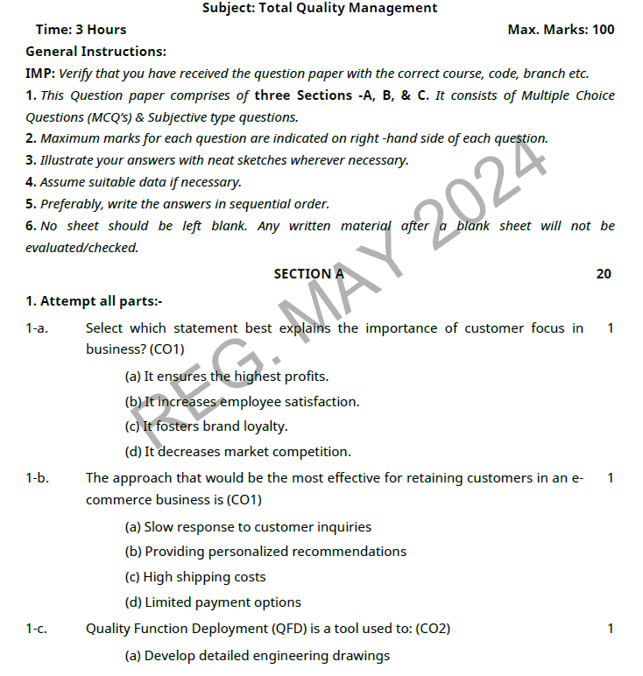
OLD QUESTION PAPERS

Slide 71
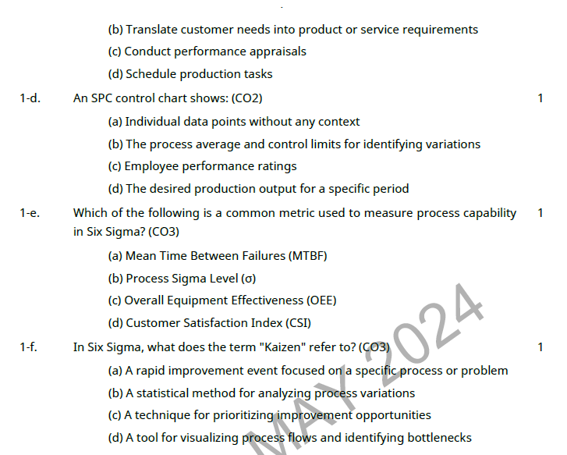
OLD QUESTION PAPERS

Slide 72
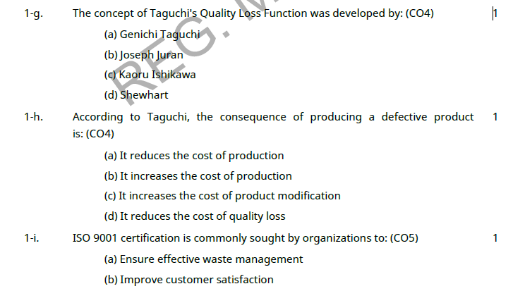
OLD QUESTION PAPERS

Slide 73
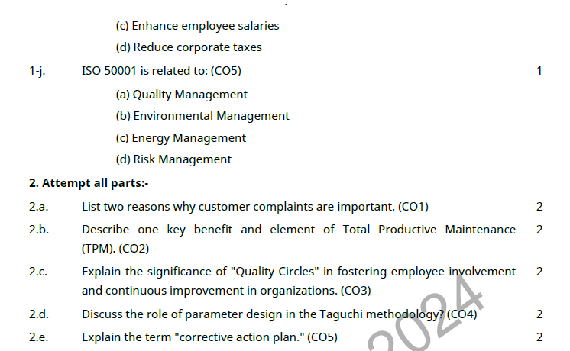
OLD QUESTION PAPERS

Slide 74
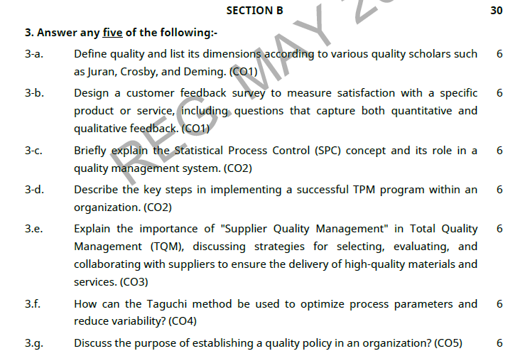
OLD QUESTION PAPERS

Slide 75
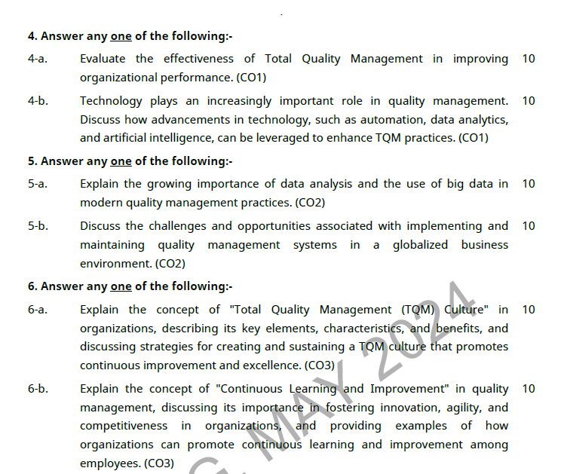
OLD QUESTION PAPERS

Slide 76
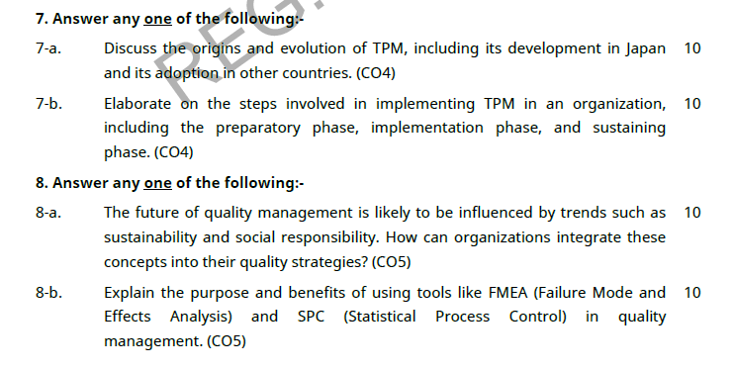
OLD QUESTION PAPERS

Slide 77
EXPECTED QUESTIONS FOR UNIVERSITY EXAM
Explain the implementation and documentation of Quality System? Implementation steps.
Explain the Benefits of ISO 14000?
Why is ISO 9000 important?
What are the objectives of reliability and how we can evaluate for a product?
State the objectives and benefits of JIT.
Explain the step followed to get ISO 9000 certification for educational institute.

Slide 78
Expected Questions For University Exam
1. How will you quantify the term quality?
2. What do you understand by quality audit?
3. Briefly explain the term QM?
4. State the good characteristics of a supplier.
5. Discuss the several dimensions of product and service quality.
6. What do you mean by warranty and guarantee? How are they being analyzed and set?

Slide 79
Expected Questions For University Exam
7. What is the important role of senior management?
8. What are the various quality statements?
9. What is a quality policy?
10. Give the need for a feedback in an organization?
11. What are the elements of customer service?
12. State Frederick Herzberg’s Two-factor theory?
13. What does an employee want?

Slide 80
Summary
Quality is customer satisfaction
Customer is the centre point for product
Need of modern approach
Deming point

Slide 81
References
Text Book
Lt. Gen. H. Lal, “Total Quality Management”, New Age International Publishers
Greg Bounds, “Beyond Total Quality Management”, McGraw Hill
Menon, H.G, “TQM in New Product manufacturing”, McGraw Hill
Reference Book
Total Quality Management” by Besterfield
“Total Quality Management” by Mukherjee
Total Quality Management” by Vijayan
“Total Quality Management- Text and Cases” by Janakiraman B and Gopal R K
https://www.researchgate.net/publication/318654507_Total_Quality_Management_Notes

Slide 82
Thank You

